Slide 1

WELCOME
We are waiting a few minutes for more individuals to join. We will start promptly at 09:10.
South Africa Works because of Public Works

Slide 2
Annual Financial Statements Inputs 2022/2023
South Africa Works because of Public Works

Slide 3
AGENDA

Slide 4

Housekeeping and Welcome

Slide 5




HOUSEKEEPING
Feel free to ask questions or make comments in the chat, Kamogelo will note them and we will go through them individually at the end of every training section
Please mute yourself unless you are acknowledged and requested to speak
If you would like to be acknowledged to raise a question or provide a comment, please raise your hand
Please turn your video off

Slide 6

1. BACKGROUND & CONTEXT

Slide 7
BACKGROUND AND CONTEXT
AFS provide information about the results of operations, financial position, and cash flows of an organisation.
PMTE received a disclaimer of audit opinion from AGSA for 2021/2022 AFS audit.
To clear the disclaimer - requires inputs and assistance from all units.
Line Functions and regions to provide additional inputs, via workbooks, to properly account for full effect of all transactions as per GRAP (Generally Recognised Accounting Practice)
Accrual accounting knowledge is critical for clean and unqualified audit

Slide 8

3.MUNICIPAL SERVICES

Slide 9
DISCLAIMER
In the following example: All characters appearing in this work are fictitious. Any resemblance to real persons, with the exception to myself, is purely coincidental. This is merely an example used to explain the thinking process used to create municipal service accruals.

Slide 10

2.1 MUNICIPAL SERVICES- EXAMPLE
I have a friend, Khaya – who has a full-time job as a an engineer, but over the past few years she has not actively managed her financial habits, and although she has a decent-earning job, she has not yet been able to start travelling the world which has been a lifelong dream of hers.
Khaya asked me to assist her in compiling a of AFS for her own personal financial use as she does not have a background or experience in financial reporting and she is of the opinion that this type of analysis would greatly assist her in getting control of her finances and to be able to track her progress of reaching her dreams of becoming a globetrotter.
Very eager to assist my friend with such a bold step in improving their quality of life, I suggested we start off with the Statement of Financial Position (Balance Sheet) and look for the information we need to compile it.
The Statement of Financial Position is commonly used to assess the position of a business in terms of financial stability and potential risk. A typical statement is likely to include a snapshot of a business's: assets, liabilities and equity (what remains of assets after deducting liabilities).

Slide 11
2.1 MUNICIPAL SERVICES- EXAMPLE
ASSETS
Less
Primary Residence
LIABILITIES
Equals
Home loans
EQUITY
Khaya’s Net financial worth
Holiday Home
Car
Cash in the bank
Unpaid electricity bill
Car loan

Slide 12
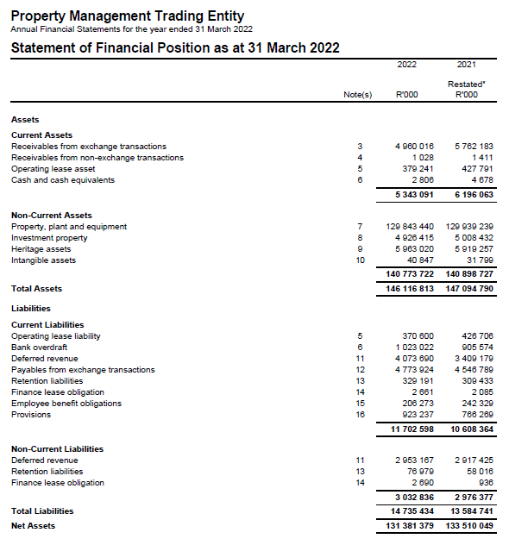

2.1 DAY-TO-DAY MAINTENANCE - EXAMPLE
Assets
Liabilities
Equity

Slide 13

2.1 MUNICIPAL SERVICES- EXAMPLE
STATEMENT OF FINANCIAL POSITION FOR KHAYA AS AT 31 MARCH 2023:

Slide 14

2.1 MUNICIPAL SERVICES- EXAMPLE
How to calculate a
Utilities Accrual:
Calculate average daily usage
Multiply with the amount of days that have not been paid to date

Slide 15
2.1 MUNICIPAL SERVICES- EXAMPLE
Electricity Accrual – Home

Slide 16
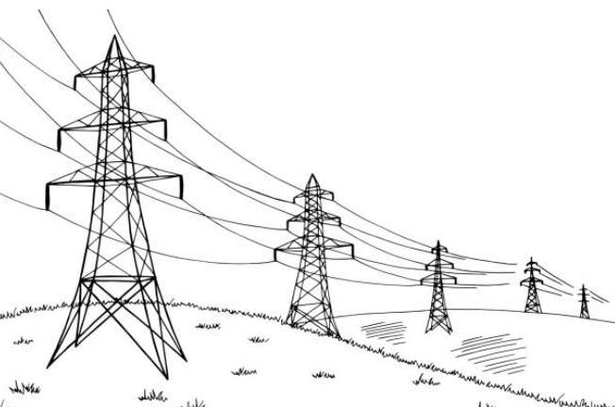
2.1 MUNICIPAL SERVICES- EXAMPLE
Electricity Accrual – Holiday Home
As there were no payment made for the holiday home in the last year, we need to get supporting documentation from the relevant municipality to calculate the accrual or just copy the final debt as per the municipality on 31 March 2023.
In this specific case, assume we got a letter from Impact Electricity stating that as at 31 March 2023, Khaya owed R20,000 for electricity at the holiday home.

Slide 17

2.1 MUNICIPAL SERVICES- EXAMPLE
STATEMENT OF FINANCIAL POSITION FOR KHAYA AS AT 31 MARCH 2023:
NOTES
N1 | Electricity - Private Home: R942.86 Electricity - Holiday Home: R20,000.00 Total Electricity Accrual: R20,942.86

Slide 18
2.2 ACCRUAL APPROACH - MUNICIPAL SERVICES
HEAD OFFICE ROLE
Obtain PMIS report reflecting all municipal payments for the year
Isolate the last payment per account for every type of municipal service (Electricity, Water, Refuse, Sewerage)
Insert list of last payments identified into the municipal accrual workbooks for each region
Distribute municipal accrual workbooks to the various regions

Slide 19
2.2 ACCRUAL APPROACH - MUNICIPAL SERVICES
REGIONAL ROLE
Obtain batches for all payments identified by Head Office and complete the municipal accruals workbook
If the region notes that the payment on the list was not really the most recent payment made for the account: - Indicate this on the worksheet and add information of the most recent payment.
Provide listing of properties where no municipal services have been paid during 2022/2023 and which are not reflected on the current outstanding mun services workbook for the 2023 financial year.
The completed workbooks should be reviewed by the line function manager and a financial unit representative then submitted to Head Office on or before the relevant due date

Slide 20
2.2 ACCRUAL APPROACH - MUNICIPAL SERVICES
Refer to Municipal Services
(Current)
Workbook

Slide 21
2.3 MUNICIPAL SERVICES – LONG OUTSTANDING
LONG OUTSTANDING MUNICIPAL SERVICES WORKBOOK
NB: If there are properties not in the listing sent by Head Office which have municipal services relating to them which needs to be accrued for, the region must provide:
a separate listing of these properties
with the estimated accrual amount (separately for 2022/23 and prior periods if not paid by 31 March 2023).
Indicate the amount per municipal service category (water, electricity, refuse, sewerage, etc.)
This is required because the payment analysis distributed by Head Office only takes into account properties which have had municipal services payments during the 2022/23 financial year.

Slide 22
2.3 MUNICIPAL SERVICES – LONG OUTSTANDING
Refer to Municipal Services
(Long Outstanding)
Workbook

Slide 23
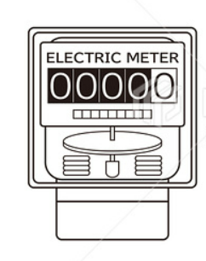
2.4 APPROACH TO RECORD MUNICIPAL PREPAYMENTS
A number of prepaid meters exist for which payments are made in advance for electrical services (and other municipal services) throughout the year.
Therefore, an asset should be created for the total value of the prepayment as this payment has been made for services which will only be rendered in the future.
In order to calculate this asset, an analysis of all prepaid electricity as at the end of the reporting period should be created.
Should the region have any other prepaid municipal services additional to electricity, they should also be added to the prepaid electricity workbook.

Slide 24
2.3 MUNICIPAL SERVICES – LONG OUTSTANDING
Refer to Prepaid Municipal Services
Workbook

Slide 25

3. DISCLAIMED OPINION
- MEANING AND IMPLICATIONS

Slide 26
DISCLAIMED AUDIT OPINION

Slide 27
DISCLAIMED AUDIT OPINION
Assets
Liabilities
Equity

Slide 28

DISCLAIMED AUDIT OPINION
Disclaimer of audit report paragraphs in 2021/2022 AFS
Payables from exchange transactions - Accrued expenses- Municipal services
Difference between recalculated amount by auditors and accrued amount in the workbook (Accuracy issue)
Payables from exchange transactions - Accrued expenses
Goods and services were received before year end, however the trading entity did not recognize the accrued expenses (Completeness issue)
PPE
Restatement could not be substantiated by supporting audit evidence (Limitation of scope)
Payables from exchange transactions - Accrued expenses- Leases
Difference between the recalculated balance and the accrued expenses (Completeness issue)

Slide 29

4. PROPERTY RATES

Slide 30

4.1 BACKGROUND TO RATES ACCRUALS WORKBOOKS
Property Rates is a tax that is charged by government on any properties that you own.
We own MANY properties, all of which lead to rates taxes being payable for them.
Even though we make monthly payments towards all of our rates accounts, GRAP financial reporting framework considers the property rates to be an annual charge, and that is why we have to include an accrual for:
All property rates that have not been paid for the months April-June, even though they do not fall within our reporting period (current rates workbook)
AS WELL AS
The Property rates that have not been paid at all throughout financial year
(long outstanding rates workbook)

Slide 31
4.2 REPORTING CURRENT RATES ACCRUALS WORKBOOKS
Current Rates Workbook
IGRAP 19
Rates accrue annually on 1 July of every financial year.
The liability to pay rates occur when the obligating event occurs.
The obligating event in this case is deemed as the ownership of the property. Since we own the property on 1 July, the rates for the entire year become an accrual on 1 July.
So as we pay on a monthly basis, we decrease our annual liability by 9 payments throughout the financial year, and an accrual for 3 months remains in the financial records.

Slide 32
4.2 REPORTING CURRENT RATES ACCRUALS WORKBOOKS
Refer to Current Rates
Workbook

Slide 33
4.3 APPROACH TO PREPARING LONG OUTSTANDING RATES ACCRUALS WORKBOOK
The majority of our property rates are paid on a monthly basis, and therefore for the majority of our properties there will only be an accrual for 3 months remaining in the financial statements as at 31 March every year.
There are however, due to various reasons, properties for which rates payments have not been made and we are therefore still liable to make payment for them in the future.
In order to calculate the final value of this accrual an analysis needs to be done to indicate all properties for which rates have not been paid to date and the total value of the outstanding rates for each of these properties. This process has not changed from our approach for unpaid property rates in previous years.

Slide 34
4.3 REPORTING LONG OUTSTANDING RATES
ACCRUALS WORKBOOKS
Refer to Long Outstanding Rates Workbook

Slide 35

5. General Guidelines

Slide 36
5.1 GENERAL GUIDELINES – WORKBOOK FINALISATION
GENERAL GUIDELINES – WORKBOOKS
Review workbooks before submission to Head Office
Ensure that columns requiring dates are filled in date format
Ensure amounts are entered in numeric format
Review high values in the workbooks for existence
Follow up on all incomplete line items
Ensure all accruals listed relate to the period ending before 30 June 2023
No Blank cells in workbooks; if not applicable type “N/A” or “R0.00”
All relevant line items to be supported by documentation and referenced for ease of use in the audit file to be kept at every region, reference numbers to be indicated on the relevant workbooks
No workbooks will be accepted by Head Office if the Review Declaration is not completed and signed off and submitted with the relevant workbooks.
Liability
where we are CERTAIN OF
Timing AND Amount

Slide 37
5.2 GENERAL GUIDELINES – WORKBOOK STRATEGY
GENERAL GUIDELINES – DEADLINES
Issues relating to the quality of review of workbooks submitted
No review by finance of inputs prepared by line function due to the non-adherence to deadline dates
Numerous errors and follow ups required on workbooks
Date format and dates after reporting period
Duplicate entries
Incomplete information
Issues relating to adherence to deadline dates
Late submission of workbooks impacts consolidation and financial statements
Submission to AG required within 3 days of RFI or COFF
Liability
where we are CERTAIN OF
Timing AND Amount
CRITICAL:
Arrange adequate staff to compile and review workbooks within deadline dates

Slide 38
5.3 GENERAL GUIDELINES – WORKBOOK FEEDBACK
GENERAL GUIDELINES – AUDIT OPINION
Problem 1: Incompleteness
Solution: Capture all transactions that meet the criteria
Problem 2: Inaccuracy
Solution: Ensure that what is captured agrees to the supporting documents (Rand values and classifications)
Problem 3: Lack of supporting documentation for amounts captured
Solution: Ensure that supporting documents are available timeously for all amounts captured
Problem 4: Overstatement
Solution: Ensure that only transactions that meet the criteria are included in the workbook.
Liability
where we are CERTAIN OF
Timing AND Amount

Slide 39

5. QUESTIONS

Slide 40
THANK YOU
South Africa Works because of Public Works

